Slide 1
Thesis update
Susan van de Sande

Slide 2
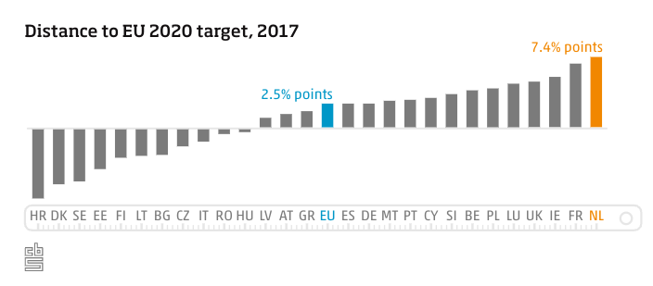
Research gap: what’s different about EDF in NL?
We have more detailed data than other papers: ours is on zipcode level instead of total level like in Li et al. (2023), Thornton et al. (2017). Our data is on annual level, so I would like to use more granular data as well.
Really high energy prices in the Netherlands, people start looking for alternatives
Nonrenewable energy prices go up, renewable energy consumption also goes up (Atems et al. (2023))
NL has a significant share of renewable energy sources

Slide 3
Research gap visualized
Previous research | Features |  |  | Model
 | Weather feature | Time feature | Demand feature | Individual model | Ensemble
Li et al. (2023) | Autumn conditions of Arctic sea-ice concentration |  | Daily UK gas and electricity data from Thornton et al. (2019) | Multiple linear regression
 | Stratospheric circulation
 | Temperature
 | Dewpoint depression
 | Wind speed
Thornton et al. (2019) | NAO |  | Gas demand data | Linear regression
 | Winter means of temperature
 | Frequency of high-demand weather types over the winter period
Huang et al. (2019) | Central pacific sea surface temperature |  |  | Linear regression, LSTM
 | Equatorial Pacific warm water
 | Western Pacific zonal wind
Zhou et al. (2022) | Historical weather |  | Historical load data | EMD | LSTM and LightGBM
Tan et al. (2020) |  |  | Power demand data |  | LSTM based hybrid ensemble learning model
Zhao et al. (2022) |  |  | Electric power load data |  | NeuralProphet-LightGBM
Huy et al. (2022) | Temperature | Special holidays of the year | Historical load data | TFT
 | Absolute humidity
 | Windspeed
Nazir et al. (2023) |  |  | London’s household daily energy consumption data | TFT, LSTM
My research | NAO | Special events | Gas and electricity demand | Benchmark model: linear regression | Prophet-TFT
 |  | Month/quarter/year indicators | Renewable energy demand |  | Prophet-LSTM

Slide 4
Research questions
RQ: Can we enhance the accuracy and lead time of energy demand forecasts in the Netherlands?
1. Sub-RQ: Is energy price influencing the energy demand in the Netherlands?
2. Sub-RQ: To what extent does the ensemble model Prophet-LSTM improve the forecasting ability of the Dutch energy market compared to benchmark models?
3. Sub-RQ: To what extent does the ensemble model Prophet-TFT improve the forecasting ability of the Dutch energy market compared to benchmark models?

Slide 5
Methodology
Data collection and preprocessing
Handling missing data
Adding new features
Normalization
Prepare data for models (feature encoding, train test split)
Model training
Training Prophet
Training models (TFT, LSTM) and baseline model (linear regression)
Combining models
Model evaluation
Li et al. (2023) use leave one out cross validation; I don’t think this is feasible with our models since they might take a long time to train, so I will probably use k-fold cross-validation (e.g. with k=3)

Slide 6
Model selection justification
Prophet
Time series forecasting model from Facebook
Handling seasonality, holidays, etc.
If we can get more granular data then I expect it to be very seasonal, e.g. lots of energy usage in the winter for heating the house, also during the summer for heat waves.
TFT
Multi-horizon and multivariate time series forecasting
Multi-horizon: useful to predict energy demand multiple steps into the future
Multivariate: multiple variables (gas consumption, electricity consumption)
Performs well on large amounts of data
Input features:
Past target values: gas and electricity usage data
Time-dependent exogenous features
Apriori unkown inputs: external factors influencing demand, e.g. weather/price
Known inputs: also influencing demand but known, e.g. day-of-week
Static covariates (not time-dependent): contextual metadata, e.g. location
LSTM
Good at capturing patterns over longer sequences
Can handle various types of features, e.g. time series, month, NAO index, price

Slide 7
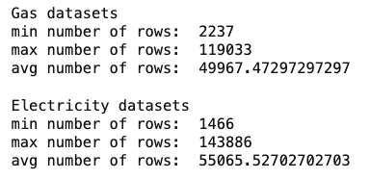
Data analysis
Merged all gas datasets together and merged all electricity datasets together
Overall, year range is 2009-2020; however: some start in 2013 (latest start date)
Data is yearly

Slide 8
Data analysis
Type of feature | Feature | Percentage of nulls
 |  | Gas datasets | Electricity datasets
General information | net_manager | 0.73% | 0.72%
 | purchase_area | 6.37% | 21.75%
 | street | 0% | 0%
 | zipcode_from | 0% | 0%
 | zipcode_to | 0% | 0%
 | city | 0% | 0%
Connection information | num_connections | 0% | 0%
 | delivery_perc | 0.14% | 0.05%
 | perc_of_active_connections | 0.14% | 0.04%
 | type_conn_perc | 3.89% | 3.06%
 | type_of_connection | 2.24% | 2.64%
 | smartmeter_perc | 29.85% | 0.33%
Consumption information | annual_consume | 0% | 0%
 | annual_consume_lowtarif_perc | 1.21% | 0.33%

Slide 9
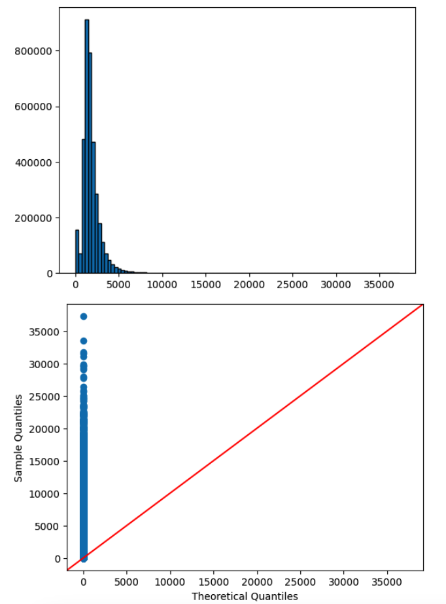
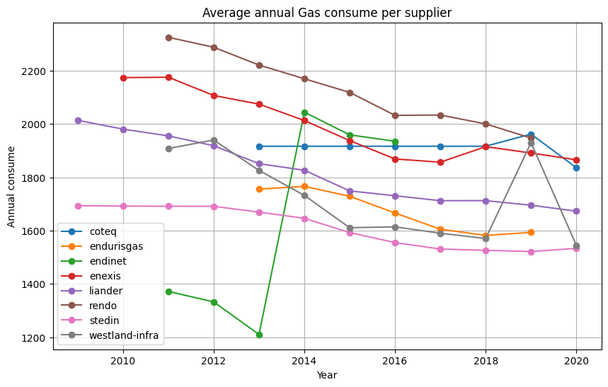
Data analysis – gas

Slide 10
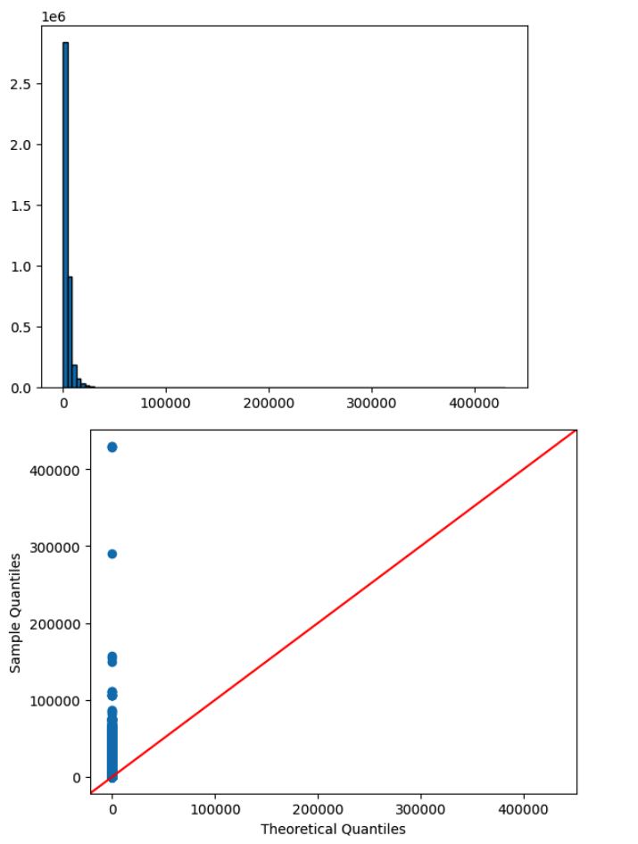
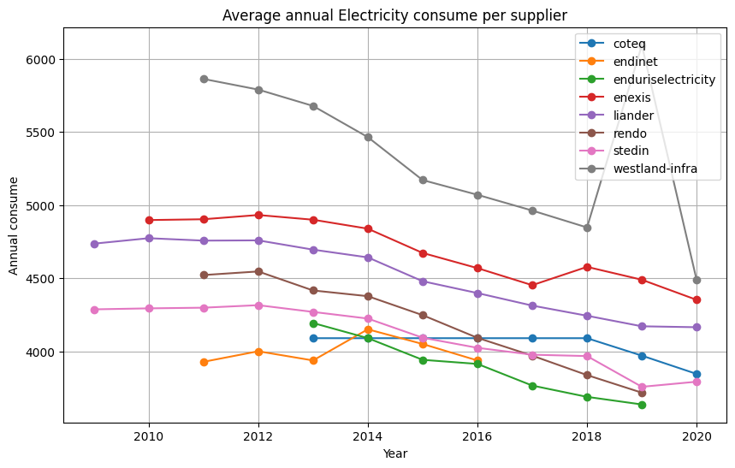
Data analysis – electricity

Slide 11
Additional data
Energy prices for consumers 2018-2023 (CBS)
Renewable energy usage 2015-2022 (CBS)
Monthly gas consumption (EuroStat)
Monthly electricity usage 1976-2023 (CBS)

